Slide 1


Slide 2







Project 4 – Group 8 ​
Mason DeJesus
Mathias Carnero
Andrew Montemayor
Judith Landa
Kids

Slide 3

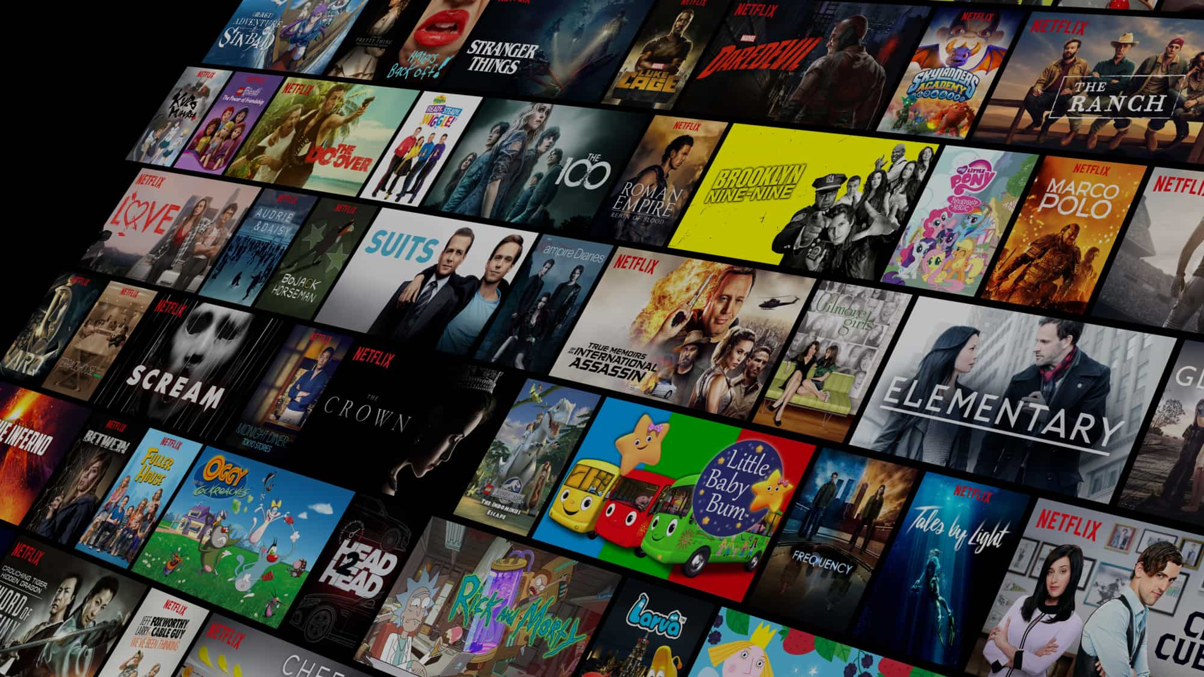
Purpose
We chose this dataset because it offers a comprehensive collection of over 16,000 movies from 1910 to 2024, giving us a large timeline to explore trends in movie ratings, popularity, and the impact of directors.
By analyzing this data, we can see how ratings and votes have varied across different directors, time periods, and cultural backgrounds.
Our primary focus is to understand how directorial influence and genres have shaped movie reception over the years.

Slide 4
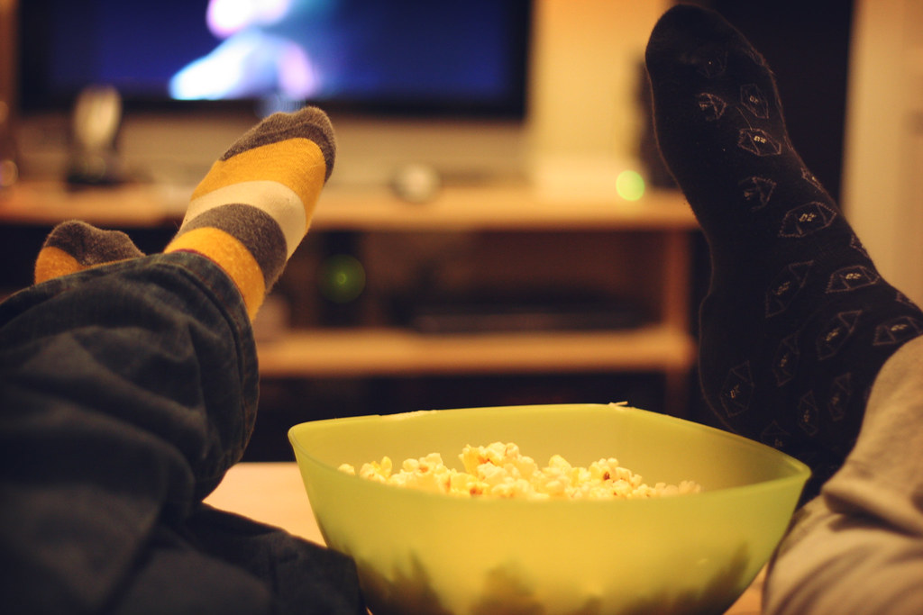
Inspiration
For our visualizations, we drew inspiration from several Tableau Public dashboards.
These examples showcase different approaches to analyzing time-series data and genre trends.
One example helped us understand how to present long-term trends, while others offered ways to visualize ratings and popularity in genres similar to our movie dataset.
These sources guided us in designing dashboards that clearly show the patterns we wanted to explore in our dataset.

Slide 5
Design concepts

Slide 6
Research Question #1
Our analysis focused on two primary research questions:
First, which directors have the highest average ratings and the most votes?

Slide 7
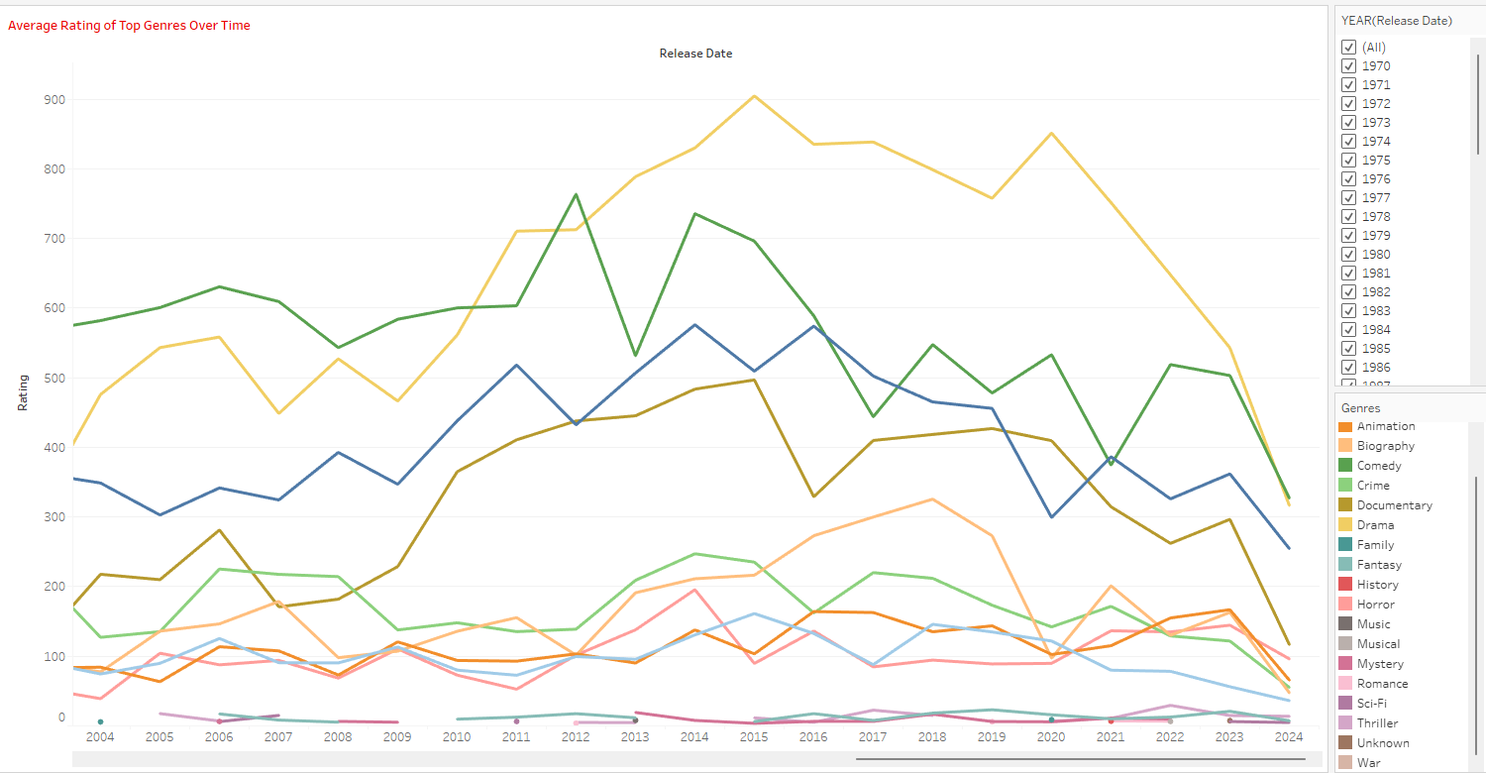
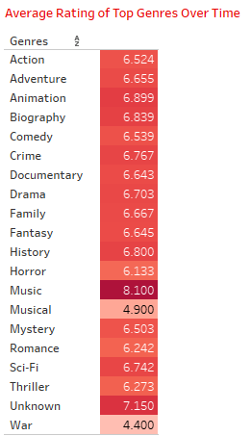
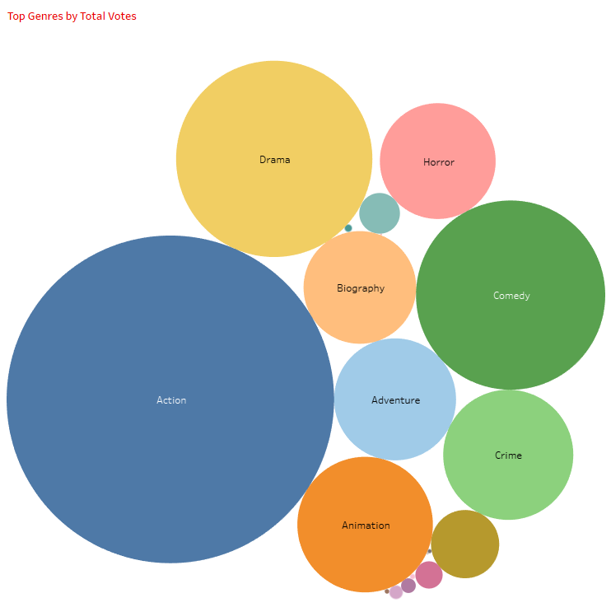
Research Question #2
Second, what are the most popular genres over time, and how do their ratings compare?
These questions guided the development of our dashboards and visualizations, allowing us to explore directorial success and trends in genre popularity in greater detail.

Slide 8
PIVOT TO LIVE DEMO
Walk us through all the html pages of your application
Show us how live ML page performs
Show us your BI visuals
How does this answer your research questions?

Slide 9
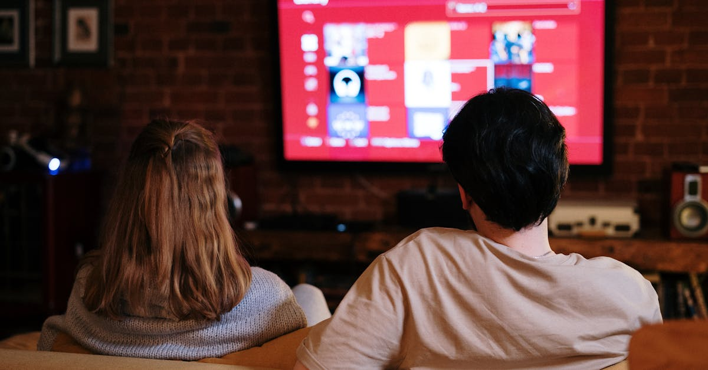
Conclusions
From our analysis, we found that directors with higher average ratings often also receive more votes, suggesting that audience engagement is linked to perceived quality.
We also saw that certain genres have remained consistently popular, while others have fluctuated over time.
Additionally, cultural factors and the availability of platforms like IMDb and Rotten Tomatoes have influenced which directors and movies receive the most attention.
This suggests that both quality and accessibility play a role in how movies are rated and remembered.

Slide 10

limitations/bias
As with any dataset, there are some limitations and biases to consider.
First, there’s a time-period bias, where more recent movies tend to get more ratings due to easier access on modern platforms.
Then we have cultural bias, where films and directors from certain regions are more represented than others, which could skew our results.
Finally, there’s a rating aggregation bias, where averaging ratings for each director oversimplifies the variation within their individual films.
These biases are important to keep in mind as they may affect the conclusions we’ve drawn.

Slide 11
Future work
Looking ahead, we see several opportunities for expanding this project.
We could use machine learning models to predict future trends in movie genres and directorial success.
Incorporating additional factors, such as actor popularity or box office performance, could give us a more complete picture.
Lastly, addressing the biases we identified by weighing ratings or votes based on the time period or cultural context would provide more accurate insights.
These steps could further refine our analysis and help us draw even stronger conclusions.

Slide 12
Credits
Starring
Judith Landa
Tableau Visualizations 2, Slide Creation
Andrew Montemayor
Tableau Visualizations 1, Web App Development
Mason DeJesus
Machine Learning Models, Data Analysis
Mathias Carnero
Web App Hosting, Development Support
Andrew Montemayor, Judith Landa, Mason DeJesus, Mathias Carnero
Write-up
Produced By
Project 4, Group 8
Written By
Andrew Montemayor
Judith Landa
Mason DeJesus
Mathias Carnero
Special Thanks To
Kaggle
For providing the dataset of over 16,000 movies spanning from 1910-2024
Metacritic
For being the source of ratings and votes for the dataset
GitHub Community
For hosting the project repository and code
Tableau Public
For visualization inspiration and design ideas
Link to GitHub Repository: https://github.com/ajmonte0920/BootCamp24-project-4-group-08
Inspiration: https://public.tableau.com/app/profile/angela.drucioc/viz/TimeSeriesAnalyse/Tableaudebord2
https://public.tableau.com/app/profile/ryansoares/viz/TrendsinTVShowGenres/TrendsinTVShowGenres
https://public.tableau.com/app/profile/jules.claeys/viz/VancouverCanucksSeasonRecapSportsVizSunday/TeamDashboard
Color Theme: https://coolors.co/palette/353535-3c6e71-ffffff-d9d9d9-284b63
https://coolors.co/palette/0466c8-0353a4-023e7d-002855-001845-001233-33415c-5c677d-7d8597-979dac
https://coolors.co/palette/000000-14213d-fca311-e5e5e5-ffffff
https://coolors.co/palette/0d1321-1d2d44-3e5c76-748cab-f0ebd8
The End

Slide 13

Thank you for watching

